Slide 1

Search Re-ranking
ACHARYA SHRIMANARAYAN POLYTECHNIC, PIPRI
Using Machine Learning
Group Members
1. Rushabh Doshi
2. Akshay Tamgadge
3. Ankit Asatkar
4. Manish Kirnake
5. Bhuvanesh Joshi
Guided by: -
Prof. Sachin R. Dave

Slide 2
Contents
Introduction
Problem Definition
Objectives
Methodology & Algorithmic Strategy
Proposed System
System Architecture
Modules
Technology
References

Slide 3
Introduction
What is a web Crawler?
Working of a web Crawler?
Limitation of Web Crawler
What is Re-ranking of results?

Slide 4
Introduction (Contd..)
World Wide Web
Web Pages
Scheduler
URL’S
Multi-threaded Downloader
Queue
Text and Metadata
Storage
URL’S

Slide 5
Problem Definition
Web Crawlers are built to crawl different web pages based on user query.
Crawling defines the basic motive of providing user with search results from web databases like Google.
The main problem of web crawlers is how to rank web pages so that user can be provided with best results.
The ranker algorithms indexes search results based on the algorithm defining the rank for each page.
To provide user with proper results we propose a three phase search engine crawler which will rank user pages based on word counts and frequency generations. We then also compare the working of proposed algorithm with existing work.

Slide 6
Methodology of Proposed System
First Phase : Fetching Results from Google
In first phase the proposed system fetches results from Google search engine with the help of Google developer API and JSON (Java Script Object Notation).
Google API Web Service
Search Query
www
JSON Service

Slide 7
Methodology of Proposed System
Second Phase : Fetching Word Count from HTML Pages
In second phase the proposed system opens the web pages internally in application with the help of JSOUP API and preprocess it. Then it performs the word count of query in web pages.
JSOUP HTML Processor
Preprocessor Rule
Top 10 links
Data Preprocessing

Slide 8
Methodology of Proposed System
Third Phase : Frequency Analysis
In third phase the proposed system performs frequency analysis based on TF and IDF. It also uses a combination of TF*IDF for ranking web pages
Second Phase Results
Classifier Algorithm (TF*IDF)
Output Ranked Results
Ranking Algorithm

Slide 9
Proposed System
In the proposed work, the system will be able to rank results using the three phase crawler system.
The results of the proposed system will be compared with existing algorithms given in literature survey.
The two algorithm that will be compared will be KNN and Naive Bayes.

Slide 10
Proposed Architecture
RANKED
RESULTS
Three Phase Search Engine
Google API Web Service
JSON Service
User Query
JSOUP HTML Processor
Preprocessor Rule
Classifier Algorithm (TF*IDF)
Ranking Algorithm

Slide 11
Modules
Data Extraction for Google Search Engine using JSON
Ranking of Pages using KNN
Ranking of pages using Frequency based NB Algorithm
Comparison Graph Generations

Slide 12
Advantages and Disadvantages
Feature learning: A randomly initialized system and trained on some datasets will eventually learn good feature representations for a given task.
Parameter optimization: This is similar to feature learning as a group of tuneable parameters can be visualized as a feature.
Works with continuous loss functions: Non-differentiable discontinuous loss functions are hard to optimize using machine learning techniques.
Limited: It is not a guarantee that machine learning algorithms will always work in every case imaginable.

Slide 13
Applications
Real Time Prediction
Multi Class Prediction
Spam Filtering / Text Classification / Sentiment Analysis
Smartphone Search Engines
Recommendation System

Slide 14
Technology
Core Java Technology with Network Support Packages.
Database not Required as everything is on the fly. (JIT)
JSON API from Google Developer
JSOUP API for HTML Extraction

Slide 15
Hardware Requirements
Processor: 1 gigahertz (GHZ) or Faster
RAM: 1gigabyte (GB) (32-bit) or 2 GB (64-bit)
Free Hard Disk Space: 16GB
Graphics card: DirectX 8 or Latest
Internet Access

Slide 16
References
Feng Zhao, Jingyu Zhou, Chang Nie, Heqing Huang, Hai Jin “Smart Crawler: A Two-stage Crawler for Efficiently Harvesting Deep-Web Interfaces” in IEEE Transactions on Service Computing January 2015.
C. Anuradha, T. Velmurugan “A Comparative Analysis on the Evaluation of Classification Algorithms in the Prediction of Students Performance” IJSR 2015
Akshaya Kubba, “Web Crawlers for Semantic Web ” IJARCSSE 2015.
Sayali D. Jadhav, H. P. Channe “Comparative Study of K-NN, Naive Bayes and Decision Tree Classification Techniques” IJSR 2014
Namish A. Diwate Kanchan Varpe “Extracting the Web Data Through Deep Web Interfaces” IJARCCE 2015.
www.wikipedia.com/Naive_Bayes

Slide 17
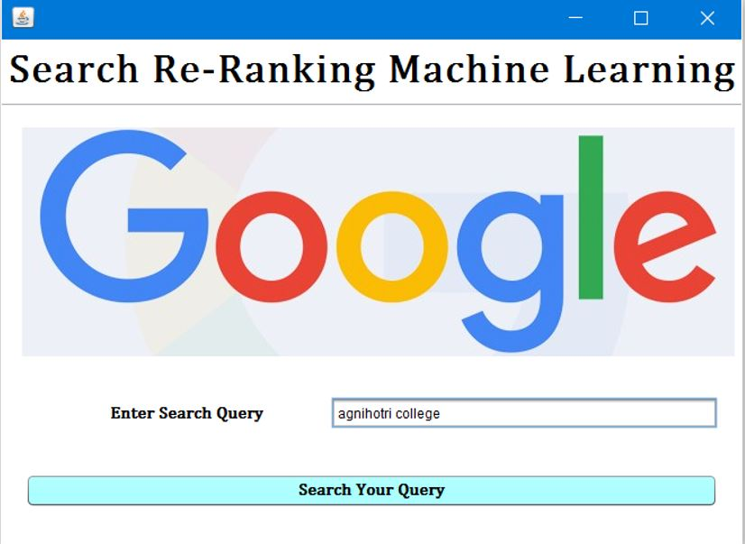
PHASE I

Slide 18
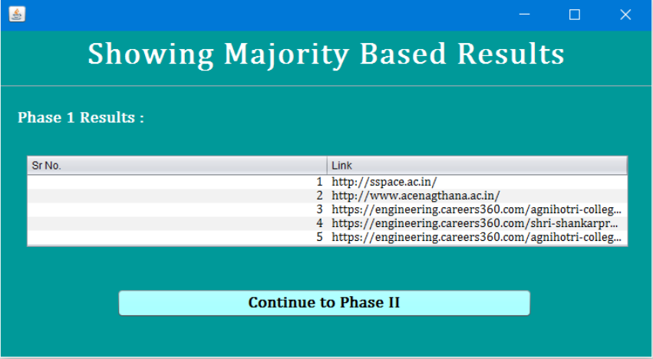
PHASE II

Slide 19
Re-Ranked Results

Slide 20
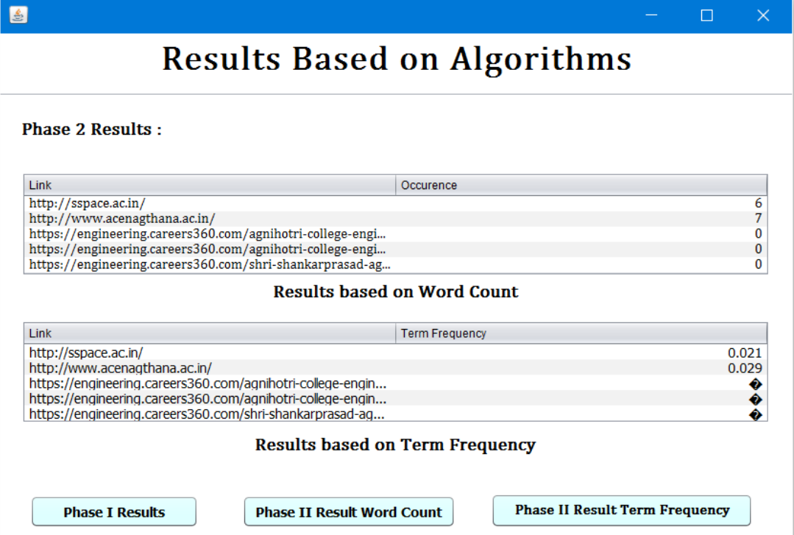

Slide 21
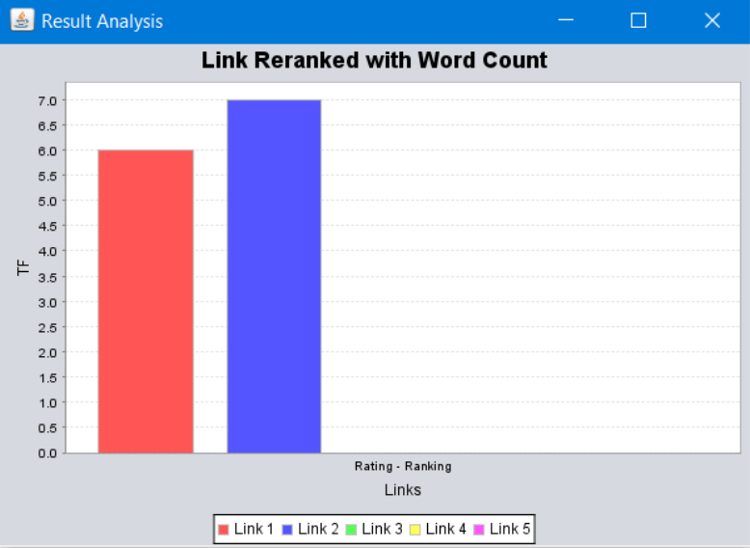
GRAPH GENERATION

